Slide 1
New Era in Quantum Network Security with Deep Learning and Zero Trust
Threat Prevention, Hybrid Data Center, IoT, SD-WAN, Unified Management, SMB
Aviv Abramovich | Head of Quantum Product Management
Russ Schafer | Head of Security Platform Product Marketing
January 2023

Slide 2
Agenda
Network Security Challenges
Threat Prevention
Data Center
Branch Office
IoT/OT
Unified Management
SMBs

Slide 3
Network Security Challenges for Enterprises and SMB
90% of data breaches due to Phishing attacks
1.5B attacks against vulnerable IoT devices
Distributed SaaS and Remote workers increasing security risk
SMBs lack IT resources to defend against cyber attacks
Notes:
Source – IDC survey, the majority of organizations (88%) globally across all verticals are suffering multiple DNS attacks – with the average being 7 attacks suffered per company per year
Source: Cisco - About 90% of data breaches occur due to phishing. Employees receive an average of 14 malicious emails every year.
Source: Kaspersky: attacks on the IoT (The Internet of Things) have pretty much doubled in the last few years.
https://www.efficientip.com/dns-2022-threat-report-highlights/#:~:text=DNS%20Attacks%20are%20Having%20Severe,of%20%24942k%20per%20attack - IDC 2022 Global DNS threats report
https://www.ciodive.com/news/security-vendor-consolidation-priority/631856/?:%202022-09-15%20CIO%20Dive%20%5Bissue:44538%5D
27 Billion IOT devices by 2025
The Internet of Things Saw 1.5 Billion Attacks in the Last 6 Months / Digital Information World

Slide 4


AI & Automation Required for Zero-Trust Security
Users & Devices
Everywhere – network, cloud, SASE, endpoint & workload
Autonomous – adaptive access control policy driven by AI, context and risk
Identity-based – policy for any workload, user, IoT and service
Scaled – manage granular policy with millions of assets
Unified policy – across all enforcement points
User
Endpoint
Mobile
IoT
OT
Data Center
Workload
PaaS
SaaS
Notes:
Remember to say it goes beyond the network to the cloud

Slide 5

TIME TO REBOOT network security
Notes:
https://www.ciodive.com/news/security-vendor-consolidation-priority/631856/?:%202022-09-15%20CIO%20Dive%20%5Bissue:44538%5D

Slide 6




A New Era in Network Security with Quantum Titan Prevention. Management. Performance.
Deep Learning Threat Prevention
Only Autonomous IoT Security
Advanced Security and Ops Efficiency
Business Driven Security Performance
Industry leading 99.7 % catch rate
Prevents 5X more DNS attacks and 4X more phishing attacks with no client
IoT threat prevention ​in 5 minutes​
On-Device Zero Day threat prevention
Unified management cloud and on-premise services
No Upgrades Required
3x Boost in performance with HyperFlow
Maestro cloud scalability on-premise with business optimized performance

Slide 7

Industry Leading 99.7% Malware Catch Rate Confirmed in 3rd party independent study
Malware Prevention Efficacy
24-Hour Discovered Malware NGFW Comparison
Malware Prevention vs Detection-Only
24-Hour Discovered Malware NGFW Comparison
100%
80%
60%
40%
20%
0%
100%
80%
60%
40%
20%
0%
99.2%
99.2%
26.7%
43.9%
72.7.%
Percent Prevented
72.7%
Percent Prevented
46.1%
46.1%
38.7%
38.7.%
Check Point | Palo Alto Networks | Fortinet | Cisco
99.2% | 38.7% | 72.7% | 46.1%
Check Point | Palo Alto Networks | Fortinet | Cisco
99.2% | 38.7% | 72.7% | 46.1%
0.0% | 43.9% | 26.7% | 0.0%
Prevent
Prevent
Detect only
Prevention versus Detection-Only

Slide 8
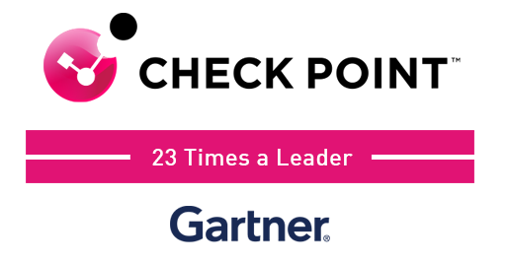

Tradition of Network Security Threat Prevention Excellence Download reports, watch other sessions, security assessment:
“Check Point doubles down on threat prevention”
Leader in Forrester Wave: ​ Enterprise Firewalls, Q4 2022​
A Leader in the Gartner Magic Quadrant ™ for Network Firewalls
Get the reports today!

Slide 9
Quantum Network Security Most advanced and scalable security
Threat Prevention
Branch office
Data center
Iot/ot
Security management
Small business
Notes:
Thank You Russ
Quantum product portfolio addresses a wide range of network security use-cases.
From small businesses to large network carriers.
Addressing the unique needs of perimeter, data-center and branch office security needs.
Let's start with the new threat prevention technology introduced in R81.20

Slide 10
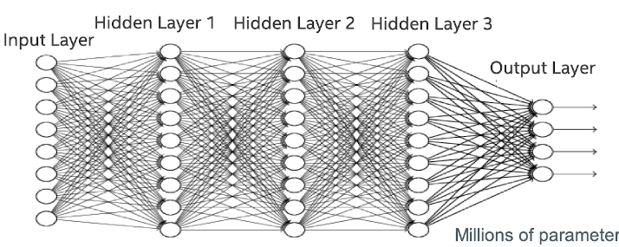
Deep Learning Reduces False Positives by 90% Deep learning vs. Machine learning
Features Definition
Classifier Algorithm
Malicious?
Certifier
OS
Compiler info
Metadata
Packer
Writable
Permissions
…etc.
SVM
Random Forest
Decision Trees
...
Classic Machine Learning
Zero day ransomware (exe)
Natural network
Malicious
Blocks
40%
Deep Learning
more attacks
Zero day ransomware (exe)
All files' bytes are processed
Notes:
During 2022 we introduced Deep Learning algorithms for our threat prevention.
Deep Learning is an evolution of Machine Learning where there is no need for a human to train the machine. Deep Learning allows for the AI to develop its own, unsupervised decisions based on millions of samples.
The result is an improvement of 40% of standard machine learning and a reduction of 90% in false positives which is amazing.

Slide 11
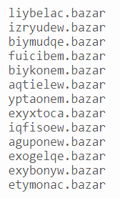



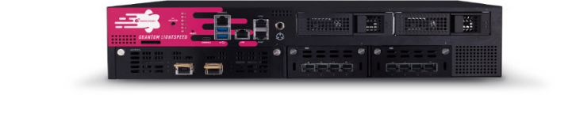
Advanced DNS Security Software Blade Blocks 5X more DNS-based attacks than signature-based technologies
Deep Learning Technologies
#1 Contact Command and Control Servers
Via Machine-generated domains (DGA)
DNS
Traffic analysis
Quantum Security Gateway
#2 Data Leak (DNS Tunneling)
Client Machine
6a57jk2ba1d9keg15cbg.appsync-api.eu-west-1.avsvmcloud.com
7sbvaemscs0mc925tb99.appsync-api.us-west-2.avsvmcloud.com
gq1h856599gqh538acqn.appsync-api.us-west-2.avsvmcloud.com
ihvpgv9psvq02ffo77et.appsync-api.us-east-2.avsvmcloud.com
k5kcubuassl3alrf7gm3.appsync-api.eu-west-1.avsvmcloud.com
mhdosoksaccf9sni9icp.appsync-api.eu-west-1.avsvmcloud.com
Notes:
The first place we introduced deep learning is our DNS Security blade:
This new blade looks at all DNS requests going through the gateway and in real-time detect and prevent malicious activity such as
communication with the attacker's command and control servers
or
Data being exfiltrated from the organization
This capability was automatically activated for all our threat prevention customers running R81.10 or later.
Within few months from activating this capability we measure a 5 times increase in prevention of DNS based attacks.

Slide 12


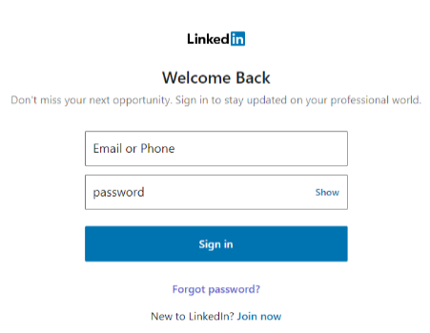


Zero-Day Phishing Software Blade Blocks 4X more Zero-Day Phishing than Signature based solutions
Quantum Security Gateway
Real time, inline AI scanning prevents zero-day phishing
Notes:
Another cool AI technology we added is Zero-day phishing prevention.
Phishing attacks are usually short lived and are taken down within a few hours thanks to quick action and signature based solutions.
However, the first hours are the most critical – a never seen before phishing site will not be detected by traditional signature based solutions.
Check Point introduced in R81.20 a new technology to prevent unknown phishing attacks.
Using AI that is looking at several aspects such as requested personal information, domain age, similarity to other sites and more
Check Point will detect in real-time and in-line such attacks and prevent the user from typing details into a malicious site.
All of this with no need for any endpoint or browser plugin on the client machine.

Slide 13
Best Threat Prevention Power by Innovated Deep Learning
Zero-Day Phishing
New Software Blade
Advanced DNS Security New Software Blade
4X
5X
More attacks blocked compared to Signature based technologies
More attacks blocked compared to Signature based technologies
40%
47%
Zero-phishing attacks MISSED by other AI based technologies
DNS-based attacks MISSED by other AI based technologies
Notes:
The results, as validated by Miercom independent testing result in over 40% more prevention compared with traditional AI based solutions
and
over 4 times better than signature based ones.

Slide 14
Quantum Network Security Most advanced and scalable security
Threat Prevention
Branch office
Data center
Iot/ot
Security management
Small business
Notes:
Moving to Data Center security

Slide 15

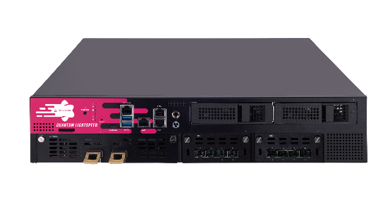



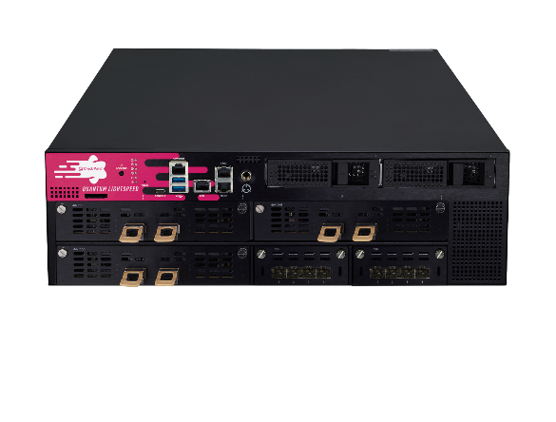
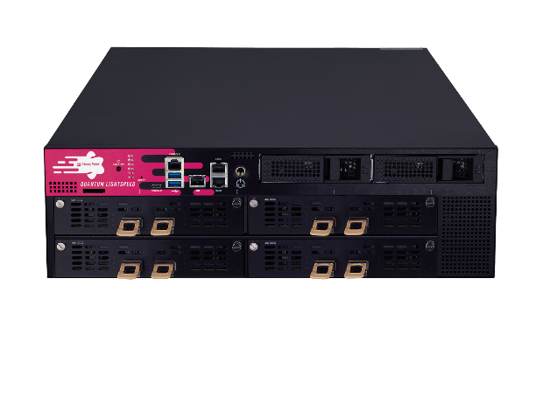
Quantum LightSpeed – More Use Cases Redefining firewall security at network speed
New series of hyper-fast firewall security gateways
Fastest FW
800 Gbps
Latency
Under 3µs
Scalable
3Tbps
QLS models
MLS models
IPv6 & VSX support
Q2 2022
Q3 2022
Q1 2023
Q4 2022
Q2 2023
Q3 2023
Elefant Flow Acceleration
and ultra-low latency
All firewall connections accelerated
IPv6 & VSX acceleration
Notes:
During 2022 we launched Quantum Lightspeed that provide exceptionally high firewall throughput for data-center use cases.
Recently we released our support for elephant flows (long connections) via ASIC acceleration while leaving other connections and threat prevention on the main CPU.
By end of Q1 this year we will continue to release more capabilities such as Maestro dedicated appliances, IPv6 and VSX support.
Later this year we will also add full acceleration for short firewall connections, IPv6, VSX and jumbo frames
allowing customers to deploy Quantum Lightspeed in all their use-cases

Slide 16
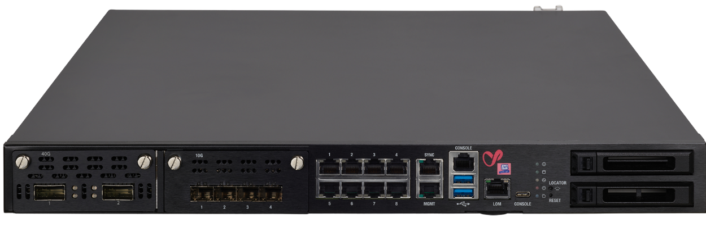
3x Throughput for VM Migration and Backup​ Hyperflow: Distribute elephant flows across multiple cores
Dynamic workload distribution​
True Parallel Processing​
No Configuration needed
CORE
CORE
CORE
CORE
CORE
CORE
CORE
CORE
CORE
CORE
CORE
CORE
CORE
CORE
Notes:
Some of you are wandering how can we deal with elephant flows without upgrading my hardware.
Well in R81.20 we introduced Hyperflow.
This amazing feature is available to all our customers running our supported appliances with 8 CPU cores or more.
Simply by upgrading to "Titan" customers will benefit from 3 times performance boost on long lived connections with full threat prevention capabilities.
This year we will continue to increase the benefits of Hyperflow by adding CIFS support as well, which hugely important for data center use cases.

Slide 17
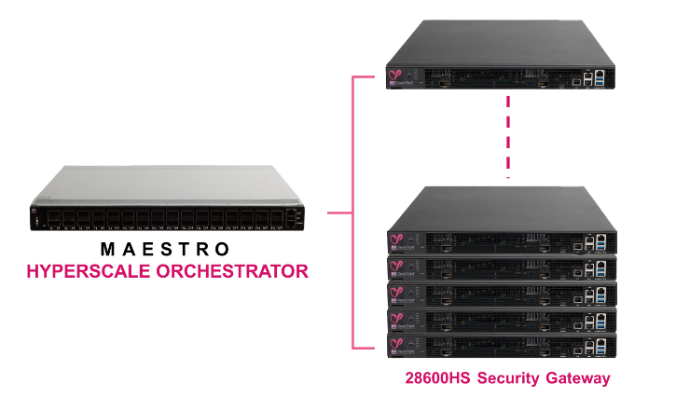
Quantum Maestro Cloud scalability on-premises
New in Titan Release:
Deep Learning Threat Prevention
Fast Forward with 800nsec latency
Business Driven Auto Scaling
MAESTRO SECURES THE WORLD’S LARGEST DATACENTERS
Notes:
Quantum Maestro is a fantastic way to maximize your Check Point gateways achieving linear scalability.
In our Titan release we introduced 3 key capabilities:
Deep learning threat prevention
Ultra-low latency of 800nsec which ideal for high frequency trading and 5G implementations
Autoscaling of compute resources between security groups to prioritize business critical applications
This year we plan to invest a lot more with Maestro user experience and simplification as well as creating a software only version we call ElasticXL.

Slide 18
Quantum Network Security Most advanced and scalable security
Threat Prevention
Branch office
Data center
Iot/ot
Security management
Small business
Notes:
Next on the list is branch office security which we will be boosting this year.

Slide 19





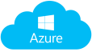
SD-WAN Security Challenges
Direct branch-to-internet connection
Datacenter security is bypassed
Local internet increases cyber-attack risk
Firewall
Inconsistent security policies
MPLS
VPN
Lack of threat visibility
INCREASED RISK OF CYBER ATTACKS REQUIRES A NEW APPROACH TO SD-WAN SECURITY
Notes:
Branch office networks are radically changing as more services such as email, CRM and more are moved from traditional on-prem datacenter to cloud services.
SD-WAN is a great technology that help you transition to use more cloud services by moving away from expansive traditional lease lines to standard broadband services, allow faster and more cost-effective deployment.
However, this is also introducing new security challenges since connections may now bypass the security offered by the datacenter.
We need to bring security back to the branch office level.

Slide 20

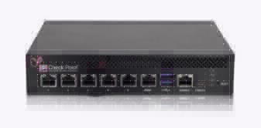
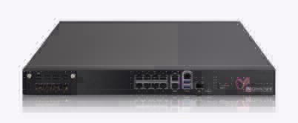

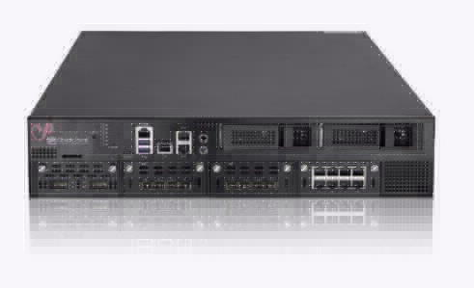
INTRODUCING
SECURITY + SD-WAN
Enhanced SD-WAN Connectivity embedded into the Industry’s Best Threat Prevention
Notes:
Check Point is announcing Quantum SD-WAN

Slide 21



Quantum SD-WAN Highest of level of security and tightly integrated connectivity
UNCOMPROMISING BRANCH SECURITY
RICH SD-WAN CAPABILITIES
SHORTEN SETUP FROM DAYS TO MINUTES
FULLY CONVERGED SASE SOLUTION
Highest level of security; 99.2% malware catch rate
Sub-second failover and auto-steering for 10,000+ apps
Single-click activation with intuitive onboarding wizard
Integrates into a complete SASE solution
[Internal Use] for Check Point employees​
Notes:
This new SD-WAN solution, internally developed, is fully integrated with all our security gateways starting from Quantum Spark all the way to our datacenter gateways.
Quantum SD-WAN provides
All Check Point highest level of perimeter security at a branch level providing the industry's best catch rate
<Next Slide>

Slide 22
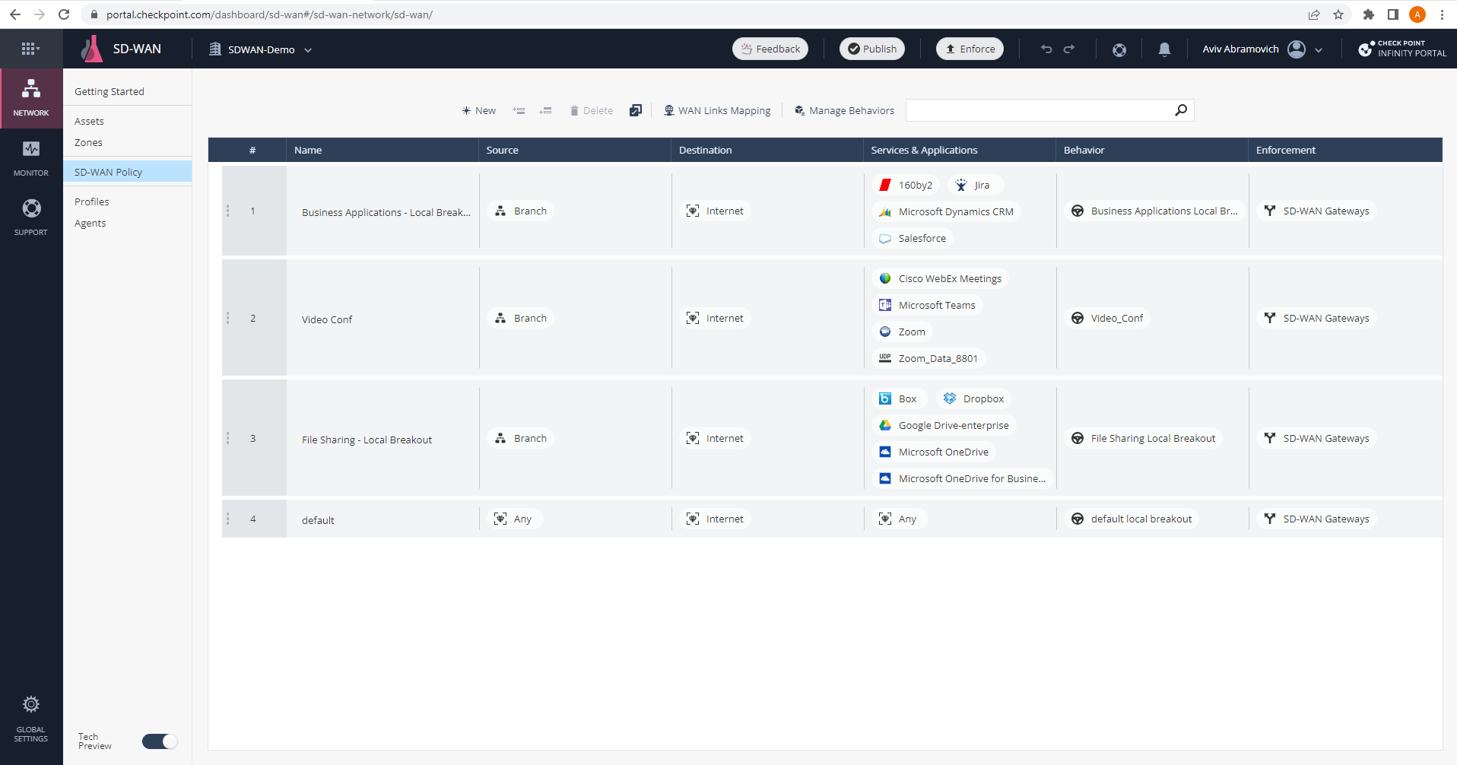
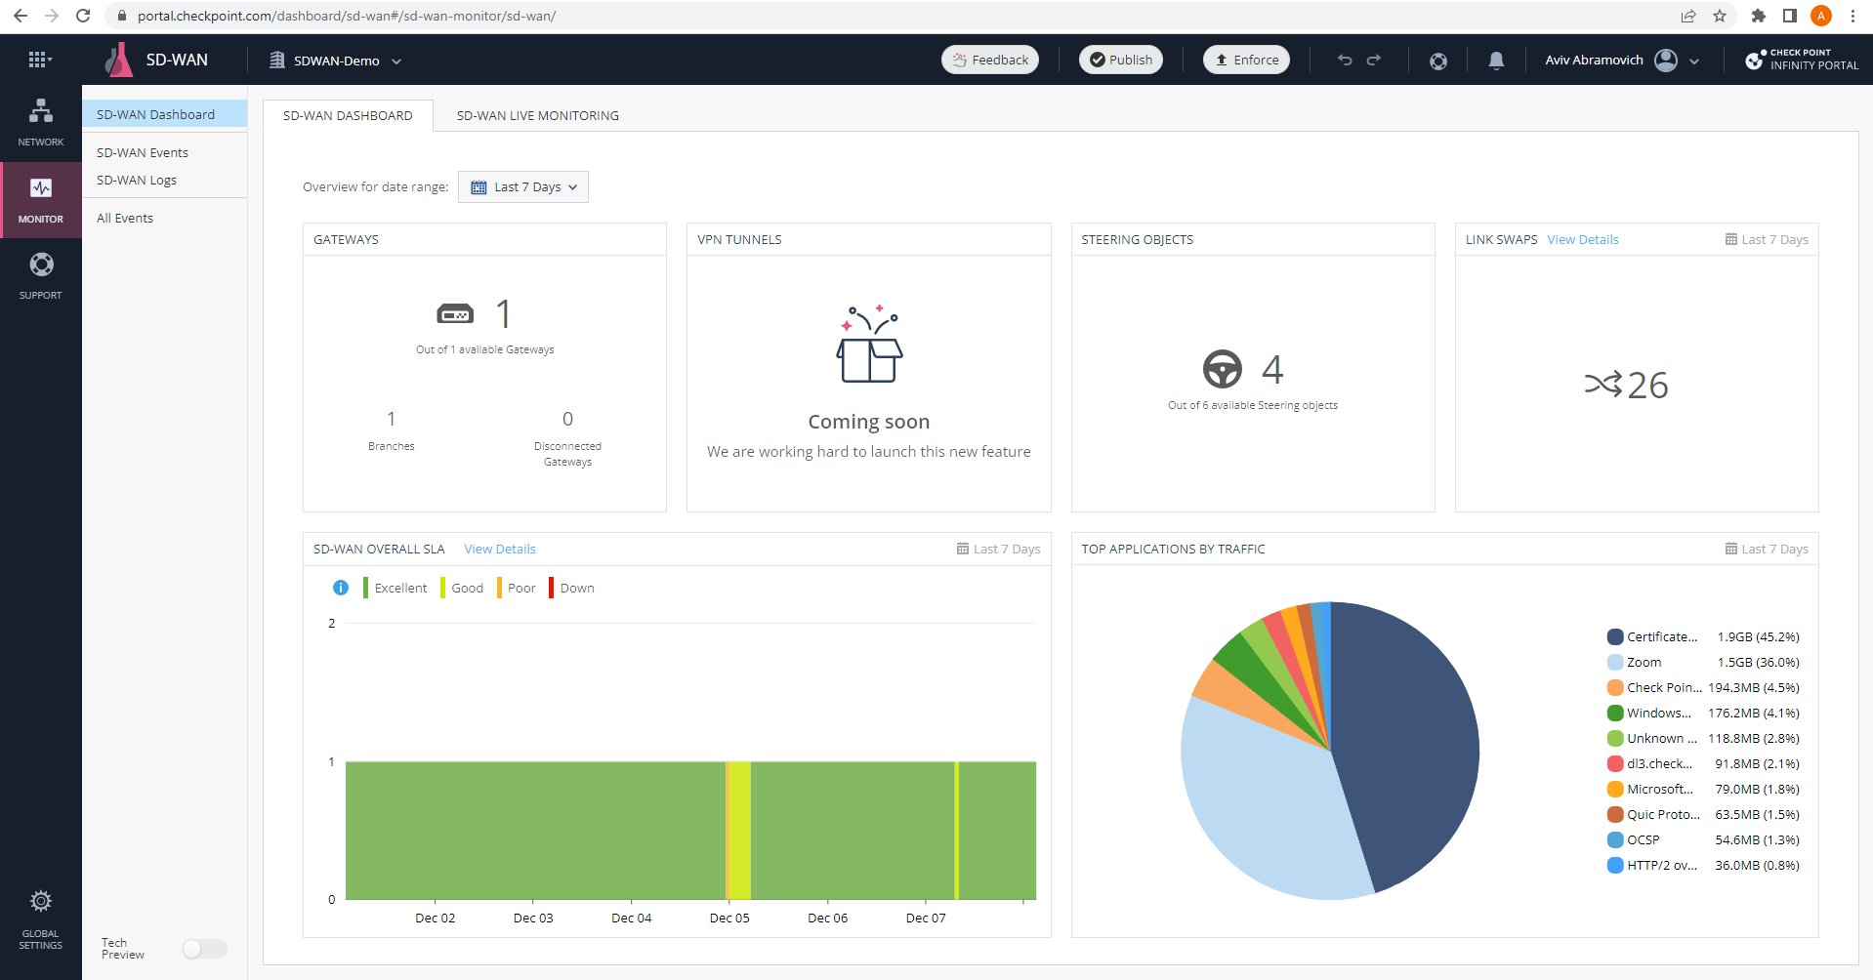
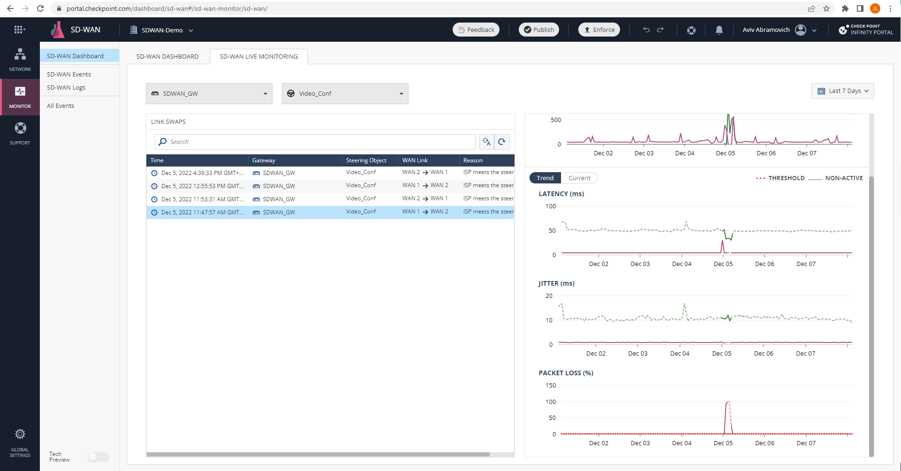
Integrated SD-WAN In Quantum Gateways
Notes:
Simple Cloud orchestration with default policies generated through a an on-boarding wizard.
Rich SD-WAN capabilities such as application steering with the highest number of over 10,000 applications support
<click>
High level central dashboard view showing networking activity across all branches
<click>
Detailed per rule logging & monitoring showing network quality stats such as jitter, latency and packet loss
Quantum SD-WAN roadmap is to fully Integrate into Check Point SASE solution.

Slide 23
Quantum Network Security Most advanced and scalable security
Threat Prevention
Branch office
Data center
Iot/ot
Security management
Small business
Notes:
In a world that is everything is connected - from our cars to home appliances we MUST address the security of these IoT devices.

Slide 24



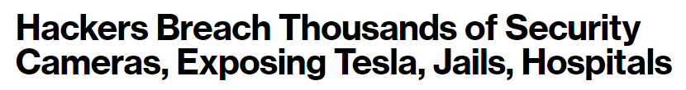
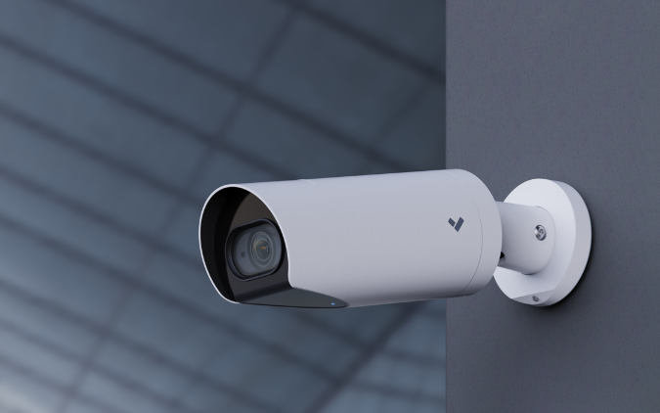


IoT and OT Attacks Continue to Expand
Notes:
We see attackers now moving to target IoT devices since these are usually:
un-managed devices
often left with default passwords and a vulnerable firmware.
However, securing IoT is no simple task as you need first map all the different devices you have (sanctioned and non-sanctioned) then figure out what is the best security practice for each of these.

Slide 25
Quantum IoT Protect Threat prevention for both network and on-device protection
Autonomous Discovery & Protection
Prevent Network IoT Attacks
Preemptive On-Device Threat Prevention
Notes:
Quantum IoT Protect provides a super easy way to secure your IoT.
IoT Protect uses 3 key principles:
Autonomous discovery and policy best practices that will allow you to secure 1000s of devices within minutes
Continuous threat prevention against IoT attacks
Both Network level protection using Quantum gateways and Device level protection using nano agents

Slide 26
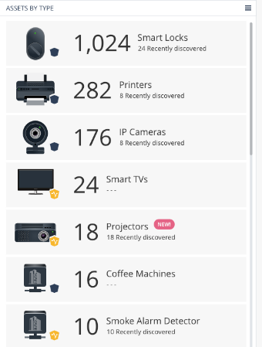
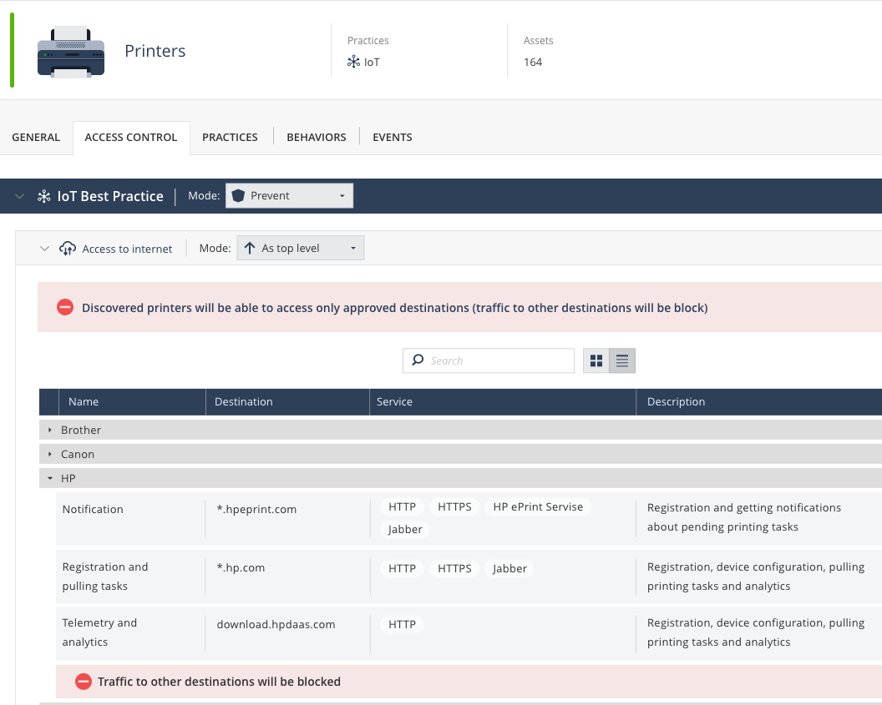
IOT Protect Network Security AI-powered Threat Prevention for IoT Devices
1
CONTINUOUS DISCOVERY
2
AUTONOMOUS PREVENTION
Notes:
IoT Protect deployment is super simple.
Once you connect your Titan based gateway to our cloud service the IoT discovery process will start
Within a few minutes we will map the IoT device type, vendor and model and offer the best IoT security profile using Cloud AI engine.
This process will be continuous and will automatically adapt to new devices that are added on to the network

Slide 27

IOT Protect On-Device security Device level nano-agent providing preemptive security
Zero-day security with runtime protection
Scan firmware to assess device risk
Continuous posture monitoring
Notes:
IoT Protect on-device security is done via nano agent integrated into the device's firmware.
It provides run-time security, scans the firmware for known risks such as default passwords and perform continuous posture monitoring.
Another important aspect is our threat prevention capability leveraging our IPS.
It contains over 300 signatures and protections for Industrial Systems, that are applied via virtual patching to protect the assets and devices.

Slide 28
Quantum Network Security Most advanced and scalable security
Threat Prevention
Branch office
Data center
Iot/ot
Security management
Small business
Notes:
The key part of maintaining your organization secure is the security management.
Let's take a look at some of the cool features added to Smart-1 Cloud during 2022

Slide 29
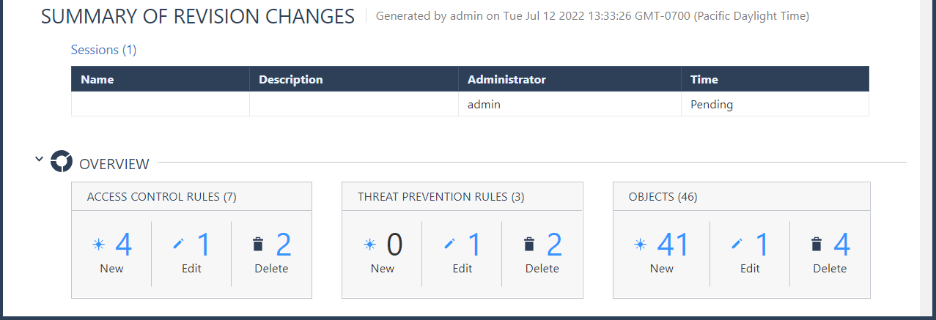
Streamline Policy Change-Review Superior management with built-in “two sets of eyes”
Policy change review and approval cycle
Audit trail for policy compliance
Notes:
A new security policy workflows to assure accuracy.
Prevent Policy Errors by adding super-approver review and leaves a detailed audit log trails on all changes made.

Slide 30
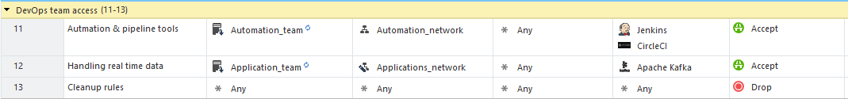
Align Security Policy to Dynamic Business Changes
Manage policies without network admin, or opening tickets
Policy changes effective immediately. No need for “policy install.”
Network Feed Objects
Notes:
The next one is Network feed
The firewall simply pings a network feed object to identify any changes and apply them to the policy without the need for a policy install.
Network Feed Objects empower DevOps to independently and instantly apply changes without bothering network admin teams or opening tickets

Slide 31
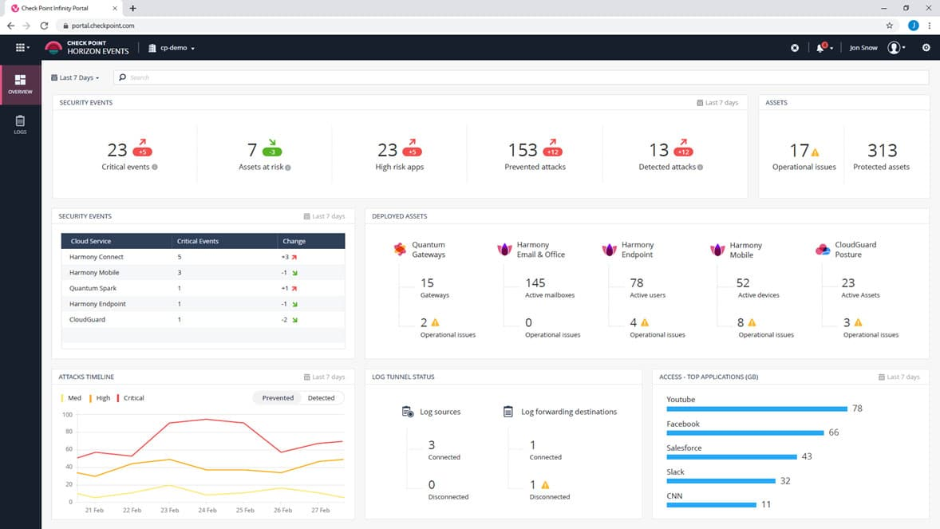
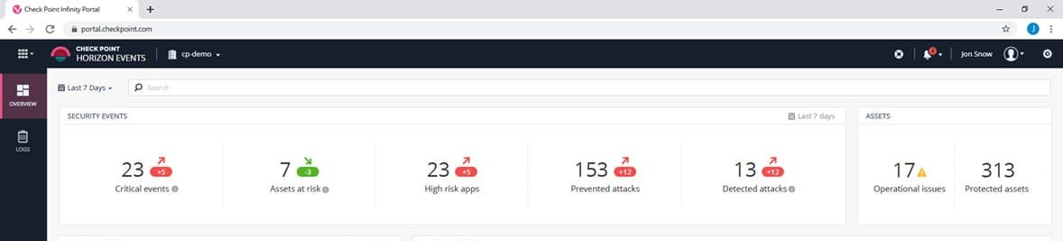
Complete Event Visibility across All Domains Search and view logs across all Check Point products
Limitless log storage
Single pane of glass for Ops
Cross-accounts view for MSPs
Notes:
Horizon Events provides you with a central logging and event repository as a cloud service.
You can connect your on-prem gateways to this service for synchronizing all logs/events for excellent and easy correlation
This service can extend into XDR from Check Point.

Slide 32

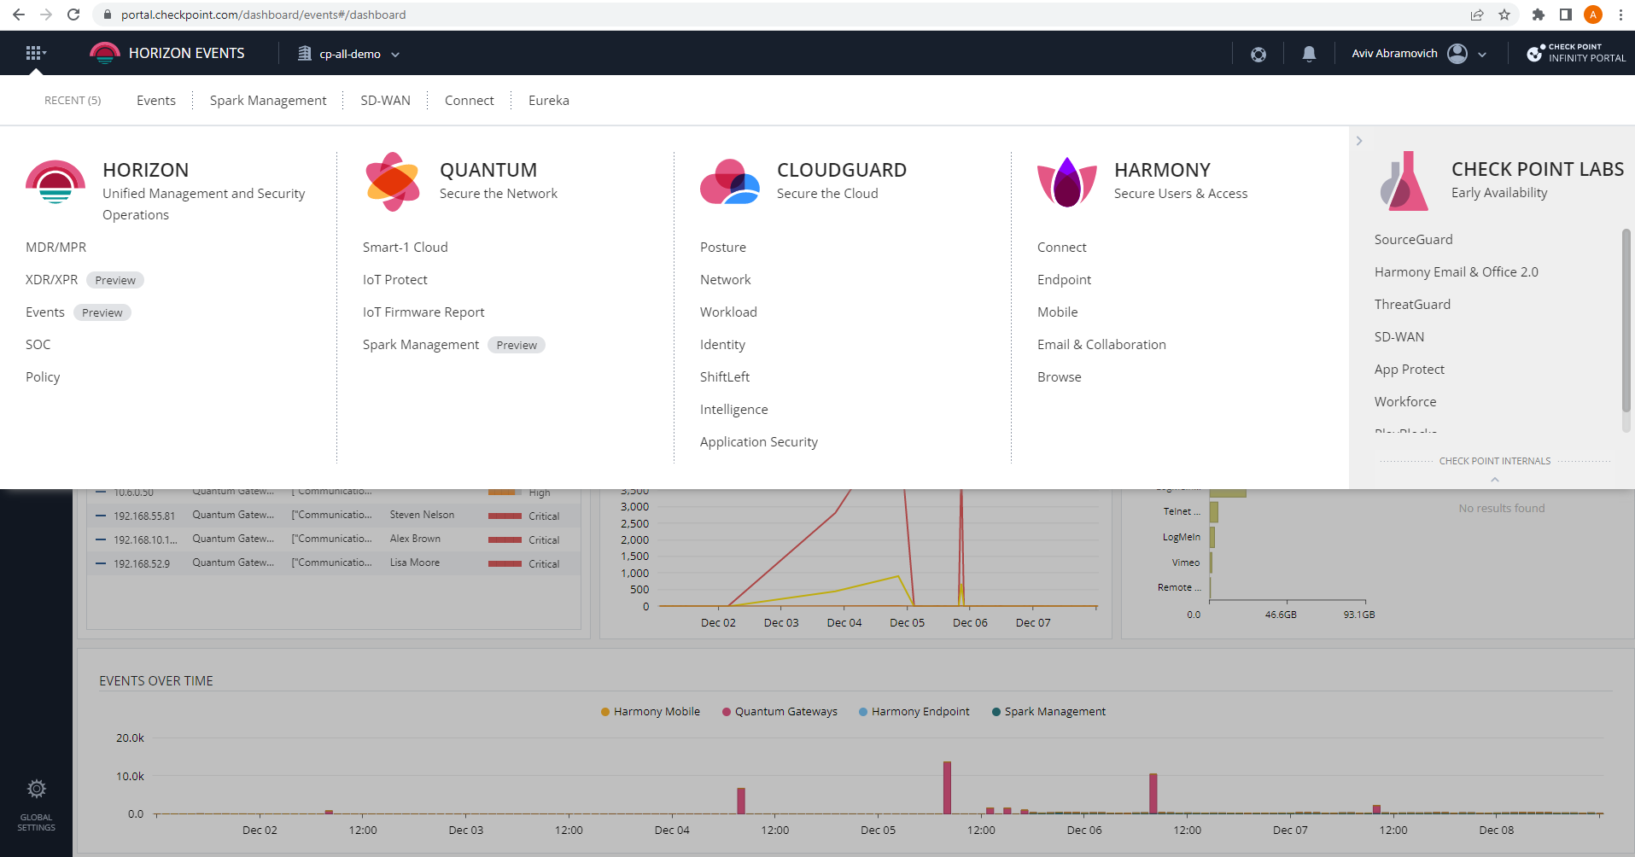
Infinity Portal Unified Management Manage all Check Point products from the cloud
UNIFIED MANAGEMENT
https://portal.checkpoint.com
Notes:
To access all these new great features simply log on to portal.checkpoint.com to start your journey.

Slide 33
Quantum Network Security Most advanced and scalable security
Threat Prevention
Branch office
Data center
Iot/ot
Security management
Small business
Notes:
The last thing I want to talk about today is small business.
We know that small businesses are an easy target for attackers and often used as means to attack larger business.
We also see a massive uptake in MSP services that are helping small business deal with these cyber challenges.

Slide 34

Infinity Security Solution for SMBs
Industry-Leading Threat Prevention & Connectivity
Unified Management & Security Orchestration
MSP Optimized Pay-as-you-go and SMB bundles
Notes:
Today we are announcing our Infinity security solutions for SMBs.
The industry leading threat prevention are available across network, endpoint, mobile and cloud email.
All can now be managed from Check Point Infinity portal with a special new MSP dashboard accompanied with a new pay-as-you-go licenses.
And … that's not all

Slide 35
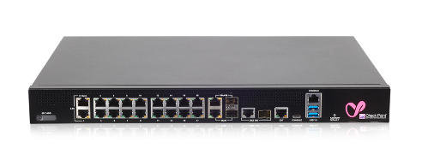


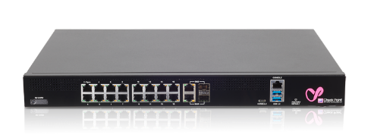


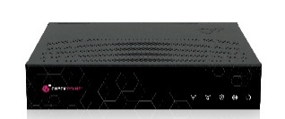

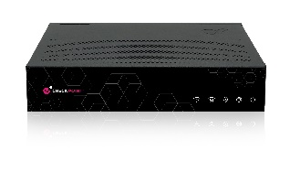
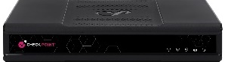
Industry-Leading Threat Prevention and Connectivity New 1500 series with WiFi6 and 5G
1800
2.6 Gbps
new
new
1600
2 Gbps
new
new
1595
890 Mbps
1575
1555
650 Mbps
1535
585 Mbps
440 Mbps
SMALL BUSINESS
MEDIUM BUSINESS
MEDIUM SIZE BUSINESS
Notes:
I am excited to announce that we are also launching a new family of small business appliances that feature:
Twice the user and connection capacity with doubled memory
WiFi 6 for enhanced wireless experience allowing to serve more concurrent devices at higher speeds.
Built 5G cellular modem delivering a massive performance boost and reliability through mobile carriers
This family is the industry's first to have it all in one device.
For the summary I turn it back to you, Russ

Slide 36
SUMMARY

Slide 37
A New Era in Network Security with Quantum Titan Prevention. Management. Performance.
Deep Learning Threat Prevention
Only Autonomous IoT Security
Advanced Security and Ops Efficiency
Business Driven Security Performance

Slide 38



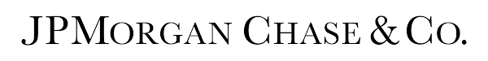














Protecting the World’s Largest Organizations
[Internal Use] for Check Point employees​

Slide 39
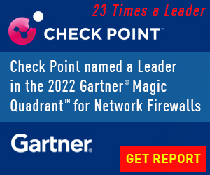
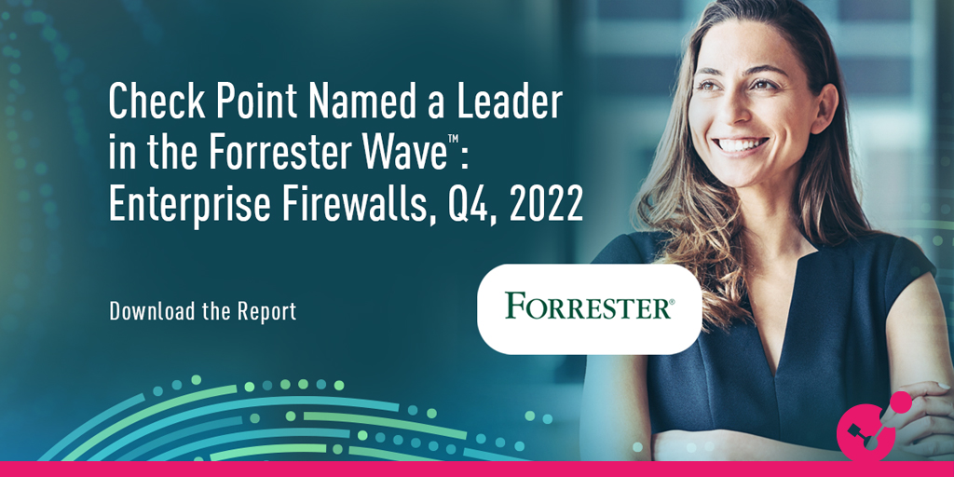
Tradition of Network Security Threat Prevention Excellence Get the reports today!
https://www.checkpoint.com/quantum/

Slide 40
Attend the Quantum CPX Sessions for More Insights
Threat Prevention
Branch office
Iot/ot
Data center
Security management
Small business

Slide 41
New Era in Quantum Network Security with Deep Learning and Zero Trust
Thank You!
Aviv Abramovich | Head of Quantum Product Management
Russ Schafer | Head of Security Platform Product Marketing
January 2023

